Slide 1
Data Tables with Pandas
Data 100
Slides originally by Josh Hug

Slide 2
Announcements

Slide 3
Pandas Data Structures

Slide 4
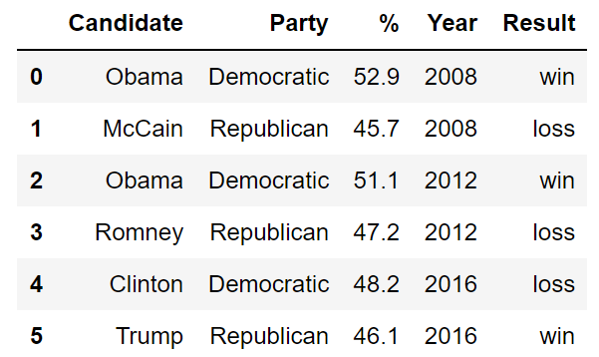
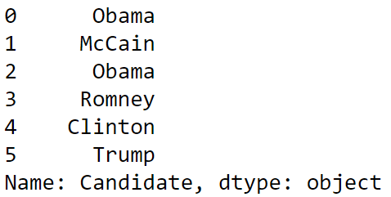
Pandas Data Structures
There are three fundamental data structures in Pandas:
Data Frame: 2D data tabular data.
Series: 1D data.
Index: A sequence of labels.
Data Frame
Series
Index

Slide 5
The Relationship Between Data Frames, Series, and Indices
A Data Frame is a collection of Series that all share the same Index.
Candidate, Party, %, Year, and Result Series all share an index from 0 to 5.
Candidate Series
Party Series
% Series
Year Series
Result Series
Non-native English speaker note: The plural of “series” is “series”. Sorry.

Slide 6
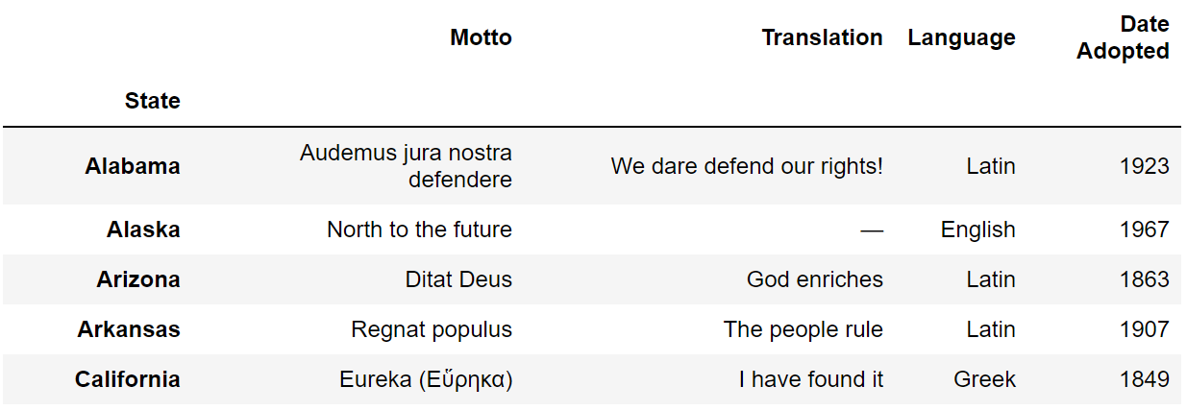
Indices Are Not Necessarily Row Numbers
Indices (a.k.a. row labels) can also:
Be non-numeric.
Have a name, e.g. “State”.

Slide 7
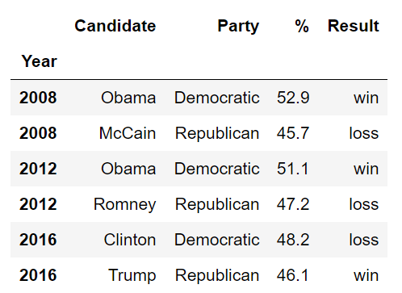
Indices
The row labels that constitute an index do not have to be unique.
Left: The index values are all unique and numeric, acting as a row number.
Right: The index values are named and non-unique.

Slide 8
Column Names Must Be Unique!
Column labels in Pandas are always unique!
Example: Can’t have two columns labeled “Candidate”.

Slide 9
Demos

Slide 10
Groupby & Pivot Diagrams

Slide 11
Series groupby/agg Summary
groupby
.agg(f), where f = sum
A
3
A
3
A
1
B
1
A
2
C
4
B
1
A
1
A
6
B
5
B
5
B
12
B
6
C
9
C
13
A
2
C
4
D
5
D
5
C
9
B
6
D
5

Slide 12
DataFrame groupby/agg Summary
groupby
.agg(f), where f = max
A
3
ak
A
3
ak
A
1
hi
B
1
tx
A
2
ca
C
4
fl
A
1
hi
B
1
tx
A
3
hi
B
5
mi
B
5
mi
B
6
tx
C
9
ak
B
6
nc
C
9
sd
A
2
ca
C
4
fl
C
5
sd
C
9
ak
B
6
nc
C
5
sd

Slide 13
Series groupby/filter Summary
groupby
.filter(f), where
f = lambda sf: sf[“num”].sum() > 10
A
3
A
3
A
1
B
1
A
2
6
C
4
B
1
B
1
C
4
A
1
B
5
12
B
5
B
5
B
6
C
9
C
9
13
A
2
B
6
C
4
D
5
C
9
5
B
6
D
5

Slide 14
Pivot Tables
R
C
A
U
3
f
A
U
3
A
U
5
A
U
2
B
V
1
f
A
V
1
A
V
1
U
V
C
U
4
f
B
U
5
B
U
5
A
5
1
A
V
1
group
B
V
1
...
B
5
7
B
U
5
f
B
V
7
B
V
6
C
4
9
C
V
9
f
D
5
NaN
A
U
2
C
U
4
C
U
4
D
U
5
f
C
V
9
C
V
9
B
V
6
f
D
U
5
D
U
5

